Slide 1
CalGreen Compliance:
Inspection & Verification of CalGreen Projects
Presented by:
Moe Fakih, MPA, LEED AP O+M, BPI, CGBP
AEF Consulting, Engineering & Construction, Inc.

Slide 2
Agenda
Code Review & Verification Methods
Code Updates
Examples from other Agencies
Discussion, Q&A

Slide 3
What Does CalGreen Mandatory Measures Cover?
For Both Residential and Commercial:
Planning and Design
Energy Efficiency
Water Efficiency & Conservation
Material Conservation & Resource Efficiency
Environmental Quality

Slide 4
California Green Building Code
Chapter 4 : Residential Requirements

Slide 5
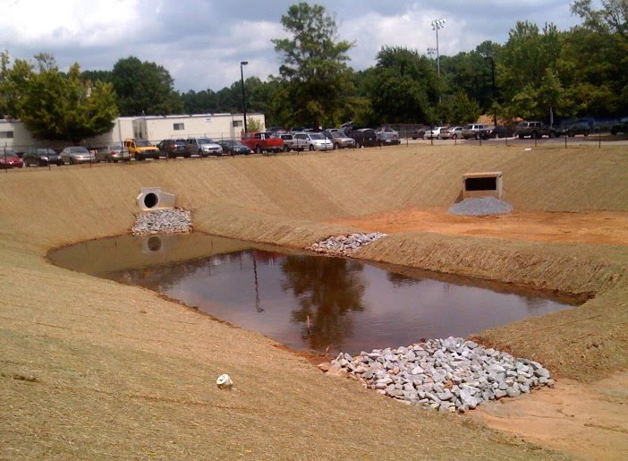
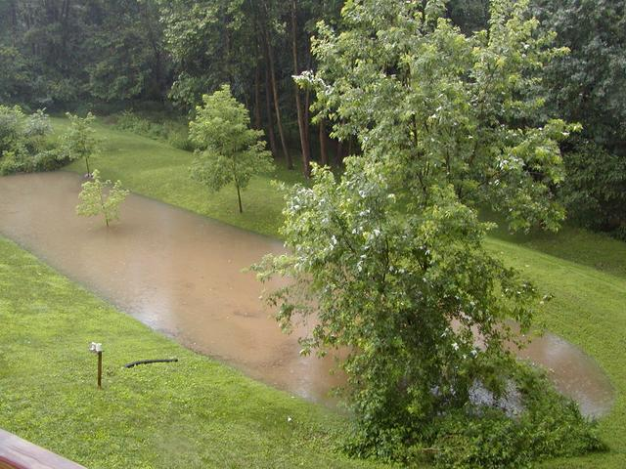
SECTION 4.106: SITE DEVELOPMENT
4.106.2 Storm water drainage and retention during construction
Following EPA’s NPDES will assist with compliance
Code Update focuses more on best management practices (BMPs)
Retention Basins

Slide 6
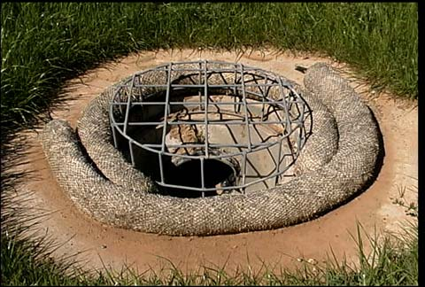
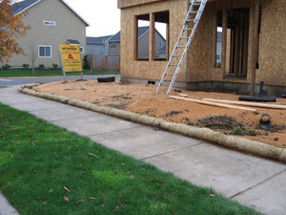
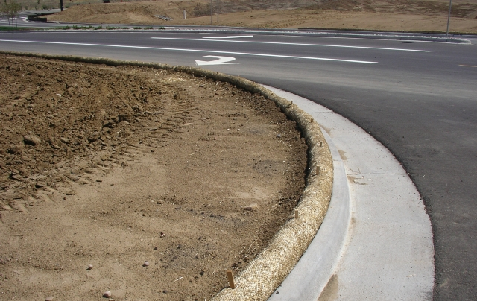
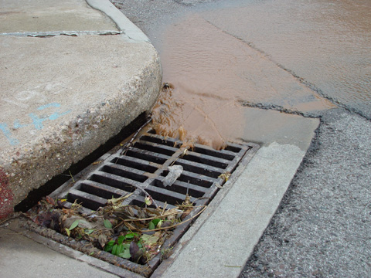
Fiber Rolls/Wattles help keep particulates & sedimentation on the construction site
Fail!

Slide 7
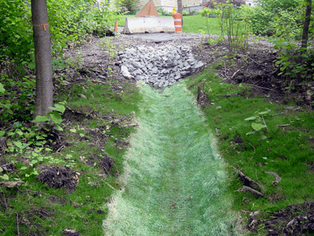
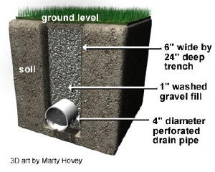
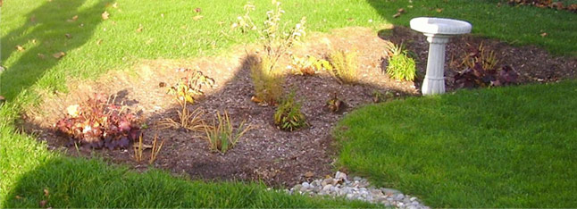
4.106.3 Surface drainage: Storm water Drainage Strategies
Swales
French Drain
Rain Garden

Slide 8
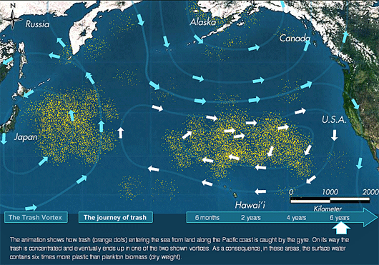
Why is storm water protection important?
Great Pacific Garbage Patch (Pacific Gyre)

Slide 9
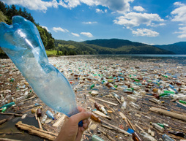
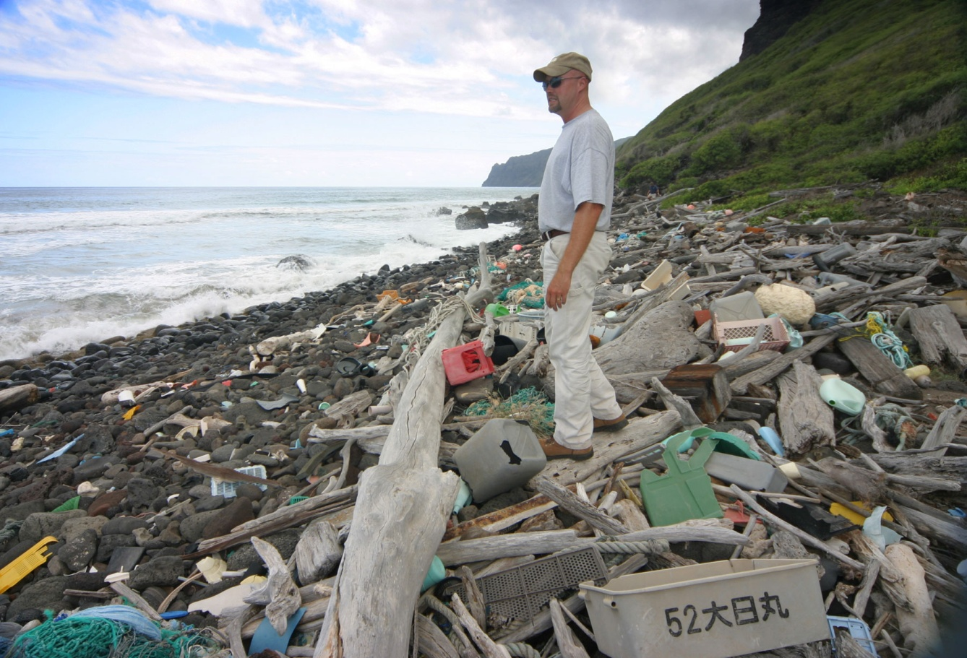
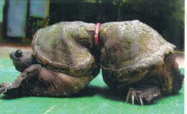
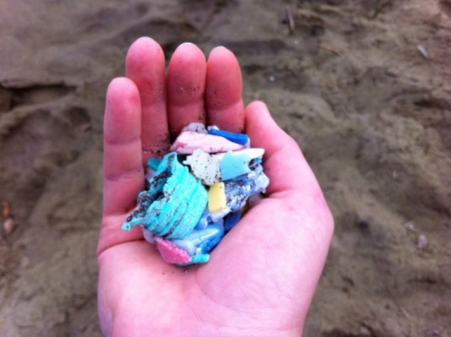
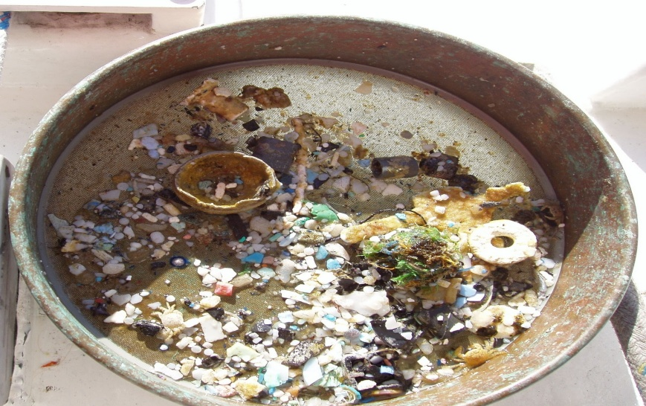

Slide 10
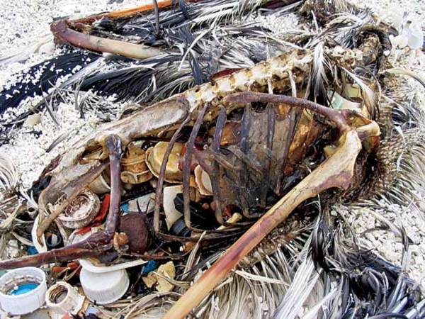
It’s not my pwoblem!

Slide 11
Division 4.2 – ENERGY EFFICIENCY
Calls for exceeding Title-24 efficiency standards by 15%
Jurisdictions are codifying their own standards
City of Manhattan Beach
Created a Green Building Task Force
All permit applicants for new residential construction and residential additions and remodels exceeding 50% valuation to exceed the performance requirements of the 2008 Building Energy Efficiency Standards by a margin of 15%.
If prescriptive measures or more stringent than mandatory measures, the stricter of the two is adopted into plans

Slide 12
Building Resource Consumption
In the United States alone, buildings account for: • 72% of electricity consumption, • 39% of energy use, • 38% of all carbon dioxide (CO₂) emissions, • 40% of raw materials use, • 30% of waste output (136 million tons annually), and • 14% of potable water consumption.
(Source: BOMA.ORG)

Slide 13
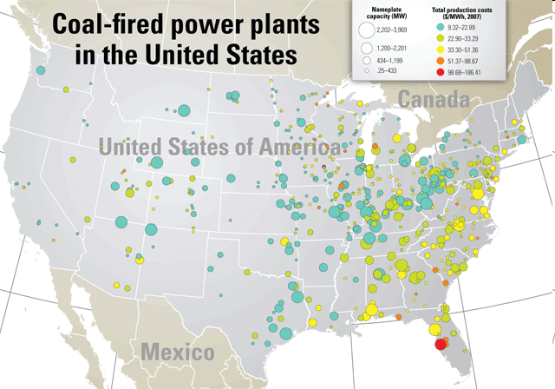

Slide 14
Pollution from Energy Production
Coal Fired Plants
59% of total U.S. sulfur dioxide pollution
18% of total nitrogen oxides every year
Release about 50% of particle pollution
Release over 40% of total U.S. carbon dioxide emissions
Release 67 air toxins (Mercury)
Natural Gas Fired Plants
Carbon dioxide, carbon monoxide, nitrogen oxide

Slide 15
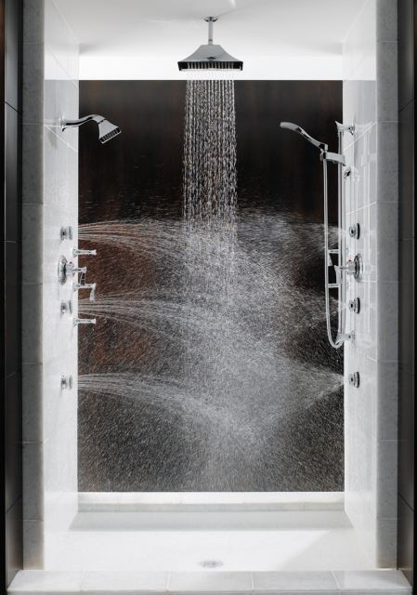
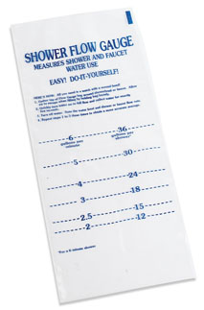
Division 4.3 – WATER EFFICIENCY AND CONSERVATION
20% Reduction in Water Use
This is achieved by:
Calculating matching flow rates on Table 4.303.2
Exceeding calculated baseline using Table 4.303.1
Multiple shower heads – Cannot exceed 2.5 GPM @ 80 PSI combined

Slide 16
SECTION 4.304: Outdoor Water Use
Automatic irrigation controls are required at end of inspection
Weather or soil moisture-based sensors
Weather based sensors
Inspection Notes:
At plan intake, a proper sensor strategy should be used. http://www.irrigation.org/swat/control_climate/.
Ensure controls are installed and/or calibrated/updated. Some companies offer calibration reports.
Types of sensors:
Historical, Historical w/ Sensor, Off-Site Data, Weather Station, Moisture Sensor

Slide 17
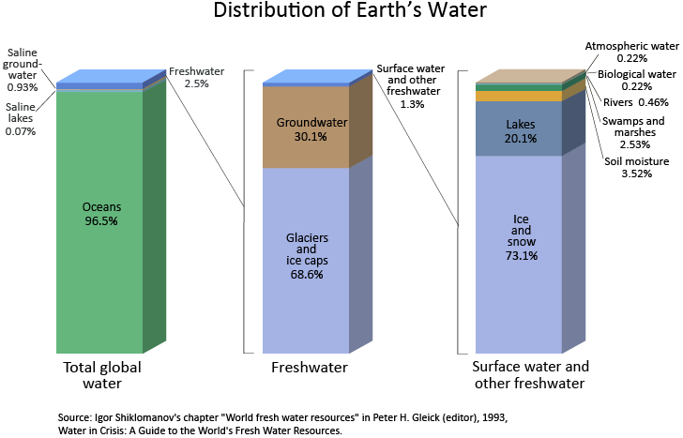
Why is Water Conservation Important?
1% of Earth’s water is usable by humans
.3% in rivers & lakes
19% State’s Energy use, 30% State’s natural gas, 88 billion gal. diesel fuel
No water, no life

Slide 18
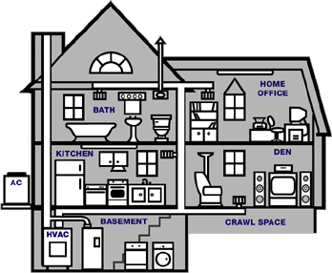
SECTION 4.406: ENHANCED DURABILITY AND REDUCED MAINTENANCE
4.406.1 Joints and openings. Openings in the building envelope separating conditioned space from unconditioned space needed to accommodate gas, plumbing, electrical lines and other necessary penetrations must be sealed in compliance with the California Energy Code.
Thermal Boundary:
Sealed openings

Slide 19
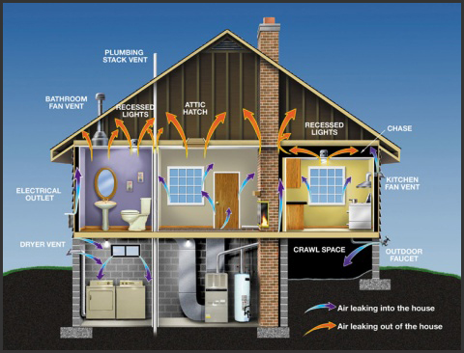

Slide 20
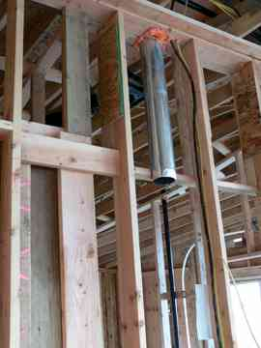
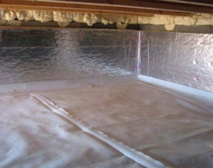
Seal with Low VOC Products
Well sealed Crawl Space

Slide 21
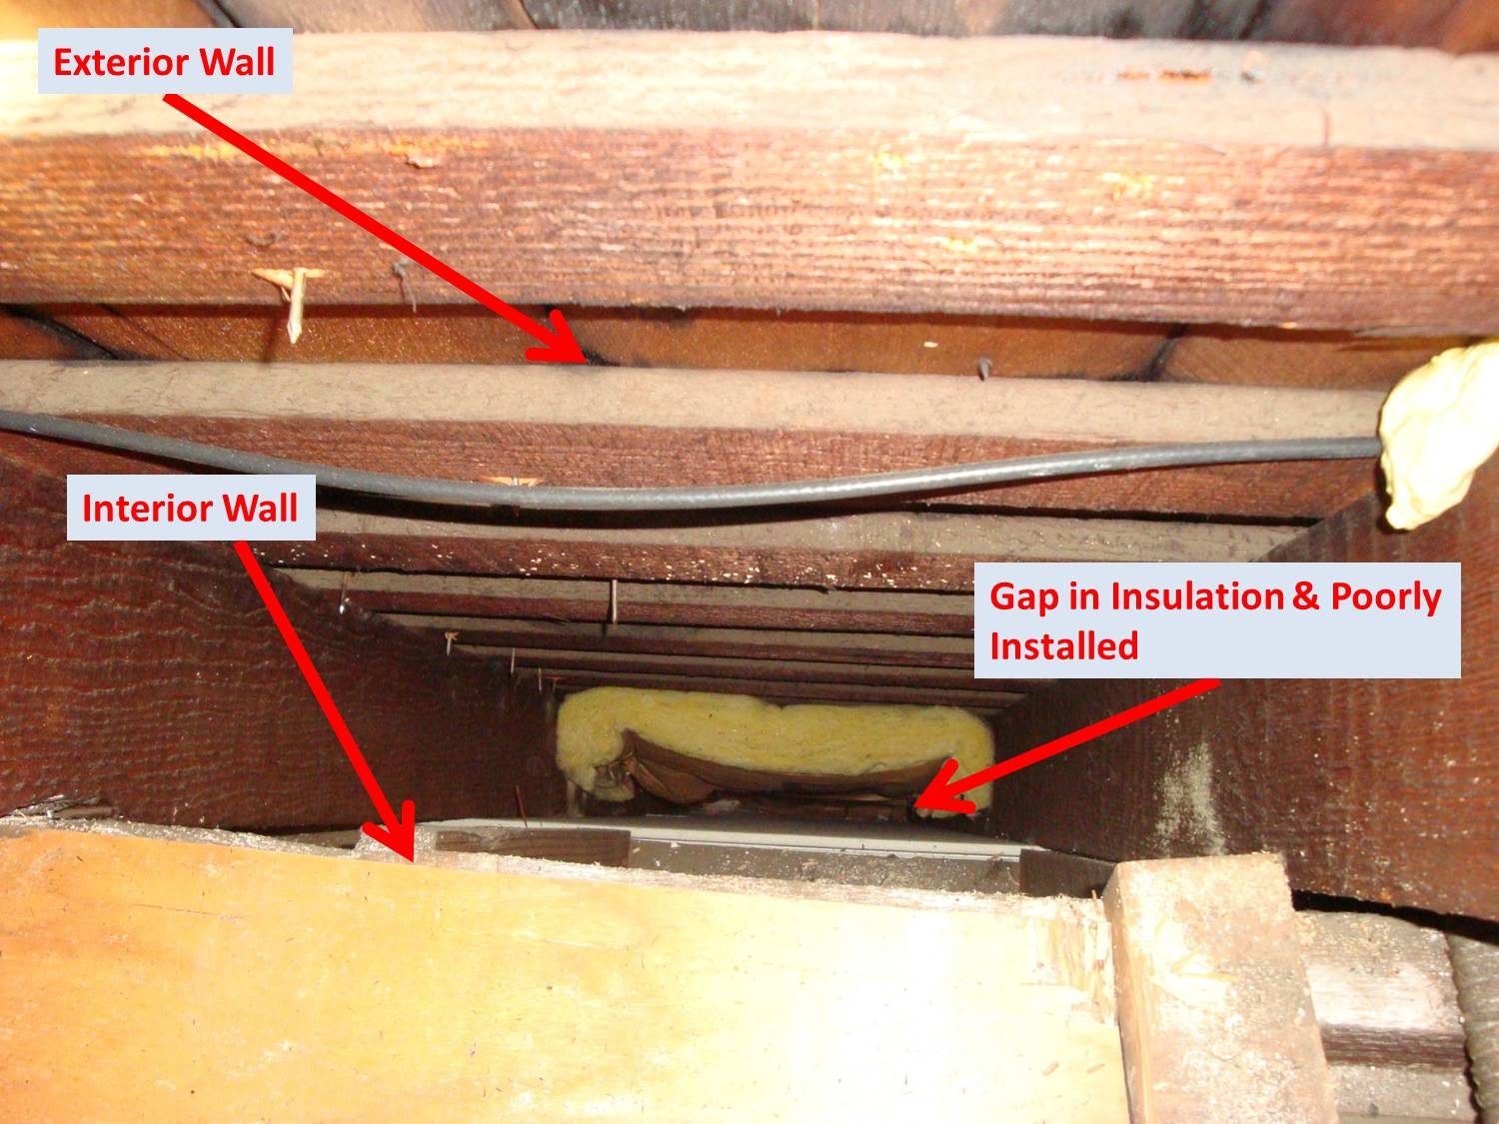

Slide 22
SECTION 4.408: CONSTRUCTION WASTE REDUCTION, DISPOSAL AND RECYCLING
Recycle and/or salvage for reuse a minimum of 50 percent of the nonhazardous construction and demolition debris, or meet a local construction and demolition waste management ordinance, whichever is more stringent.
Easier to comply in South Bay and in most California municipalities
Typically already enforced through a construction & demolition waste program
4.408.2 Construction waste management plan.
Demo trades or Subtrades that create waste shall sign off
Address toxic substances & handling
WMP Should be located on site

Slide 23
SECTION 4.410: BUILDING MAINTENANCE AND OPERATION
An owner’s manual will be given to the home owner once the home is completed
Similar to a vehicles owners manual describing maintenance frequencies and how one is to operate the home’s systems.
Educate clients on how to reduce utilities
Local public transportation and car pooling information
Solar incentives
Special inspection requirements
Companies can draft the plan for a fee

Slide 24
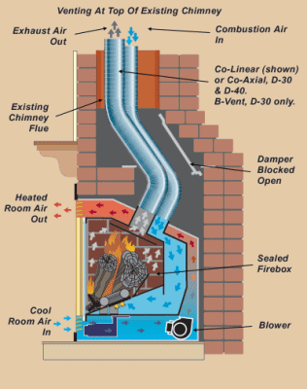
Direct Vent Example
(Source: http://mendotahearth.com)

Slide 25
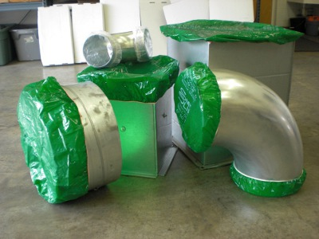
SECTION 4.504: POLLUTANT CONTROL
4.504.1 Covering of duct openings and protection of mechanical equipment during construction.
Protect all openings & Equipment.
Create a Duct and Equipment Protection Plan (Not required)

Slide 26
4.504.2.1 Adhesives, sealants and caulks.
4.504.2.2 Paints and coatings
4.504.2.3 Aerosol paints and coatings
4.504.3 Carpet systems
4.504.4 Resilient flooring systems
4.504.5 Composite wood products
Verification:
Ensure that the products meet VOC levels specified by CalGreen.
See if VOC tables are included in plans
Make sure product cut sheets listing VOC levels are on site
Compare product being used with cut sheets and VOC tables

Slide 27
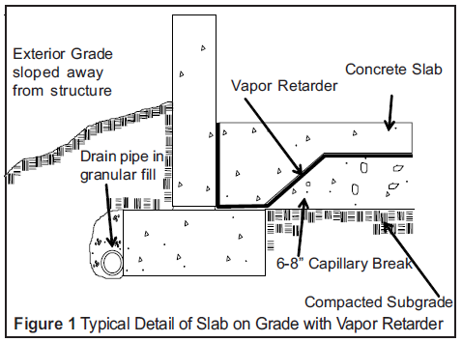
4.505.2 Concrete slab foundations
Now require a capillary break (Polyurethane)
Inspect prior to concrete slab foundation installation
Capillary Break Example:

Slide 28
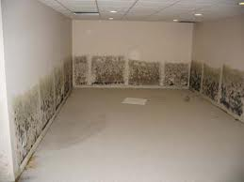
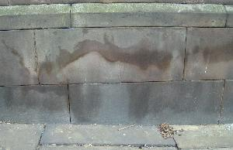
Damage as a result of capillary intrusion

Slide 29
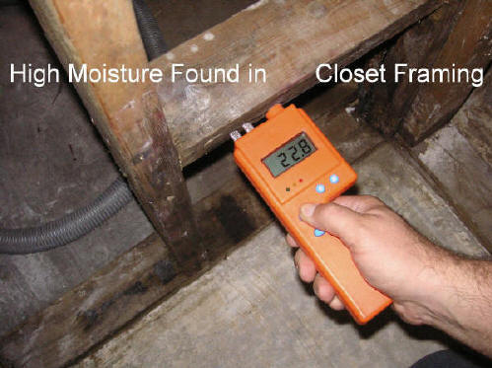
4.505.3 Moisture content of building materials
Moisture readings shall be taken at a point 2 feet (610 mm) to 4 feet (1219 mm) from the grade stamped end of each piece to be verified.
At least three random moisture readings shall be performed
Readings Below 19%, ok

Slide 30
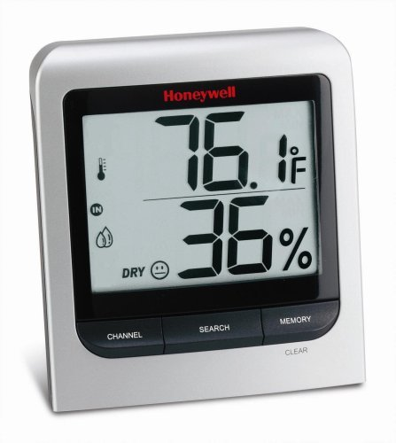
4.506.1 Bathroom exhaust fans
Fans are often turned off prematurely so mold still grows
Fans shall be energy star compliant
Humidistat is required unless fan is part od a whole house system
50% to 80% humidity is an acceptable range

Slide 31
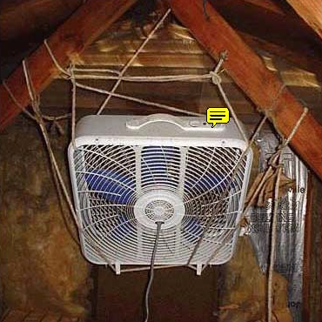
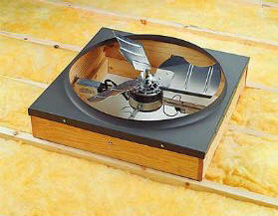
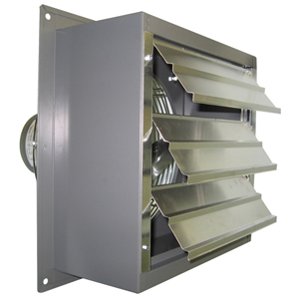
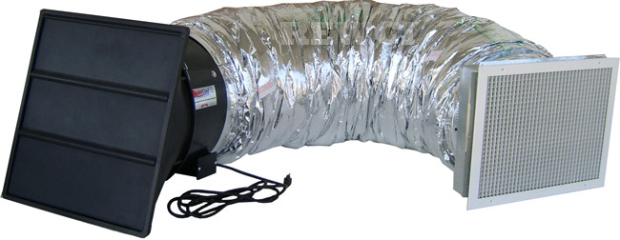
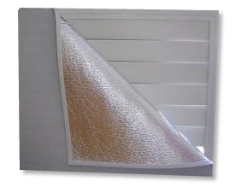
SECTION 4.507: ENVIRONMENTAL COMFORT
Probably not code compliant
Whole House Fans
Insulated R-4.2 Cover (not ideal)

Slide 32
4.507.2 Heating and air-conditioning system design
Heat loss and heat gain - ACCA Manual J, ASHRAE handbooks or equivalent
Duct systems sized - ACCA 29-D Manual D, ASHRAE handbooks or equivalent
Heating and cooling equipment - ACCA 36-S Manual S or equivalent
Details typically resolved during plan intake
Refer to plan specs or attached reference standards for compliance
Some agencies may elect to have third party HERS raters perform inspections

Slide 33
CHAPTER 5:
NONRESIDENTIAL MANDATORY MEASURES

Slide 34
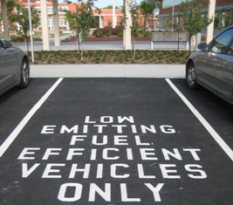
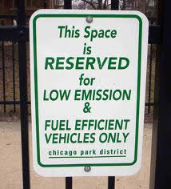
SECTION 5.106 SITE DEVELOPMENT
5.106.1 Storm water pollution prevention plan
Ensure BMPs are being applied, similar to NPDES enforcement
Ensure a plan is being applied is placed within job site binder
5.106.4 Bicycle parking and changing rooms
5.106.5.2 Designated parking
According to code, stalls shall be marked “CLEAN AIR/VANPOOL/EV”
Minimum space requirements need to be reached per code
Misleading

Slide 35
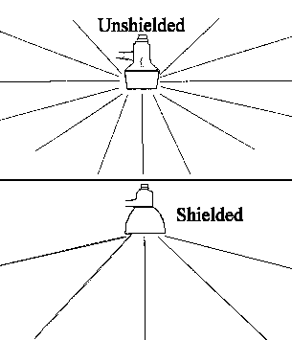
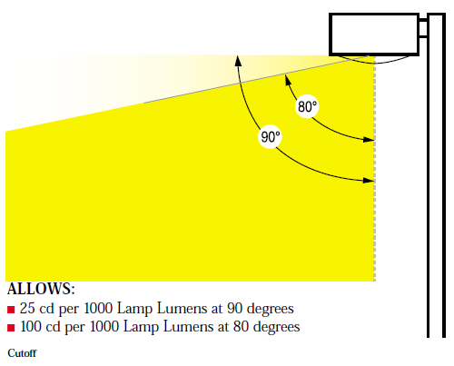
5.106.8 Light pollution reduction
A photometric study should be completed at plan intake
Ensure lighting falls into the footprint of the property. Lighting should not be directed up into the night sky
Cutoff Luminary

Slide 36
Division 5.2 – ENERGY EFFICIENCY
Moving target for now.
5.201.1 Scope. For the purposes of mandatory energy efficiency standards in this code, the California Energy Commission will continue to adopt mandatory building standards.
Lighting should exceed Title-24 by 15%, not shall.
May be resolved by 2013 as State adopts 15% above Title-24
Prescriptive Requirements:
Insulation
Glazing / Fenestration
Thermal Mass (Package C only)
Radiant Barriers
Space Conditioning Systems
Water-Heating System

Slide 37
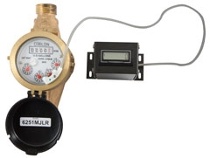
Division 5.3 – WATER EFFICIENCY AND CONSERVATION
5.303.1.1 Buildings in excess of 50,000 square feet. Separate submeters shall be installed as follows:
For each individual leased, rented or other tenant space = 100 gallons/day
For laundry or cleaners, restaurant or food service, medical or dental office, laboratory, or beauty salon or barber shop projected to consume more than 100 gal/day
Sub meters should be identified at plan intake, however field verification can identify realities that plans may not uncover
Tenant identification, changes during construction

Slide 38
5.303.2 Twenty percent savings
Similar to residential
Multiple shower head limitations in effect
Best Practices: Dual flush toilets, high efficiency toilets, high efficiency shower heads, water aerators, low flow faucets, low flow or waterless urinals
5.303.4 Wastewater reduction
Pressure assist toilets at 1.28 gallons per flush or lest are ideal
Pint urinals @ .125 gallons per flush may be more effective than waterless urinals
Existing sewer lines may be sized for larger quantities of water, backups may occur.
Ensure installed systems meet minimum requirements. Ask for product cut sheets.

Slide 39
SECTION 5.304: OUTDOOR WATER USE
5.304.2 Outdoor potable water use
Submeters required for indoor & outdoor use
For new service for landscape areas Between 1,000 square feet and 5,000 square feet
Verify installation of meters
5.304.3 Irrigation design
Install irrigation controllers and sensors in new nonresidential construction with between 1,000 and 2,500 sq. ft. of landscaped area
Verify sensors are installed and functioning
5.304.3.1 Irrigation controllers
Similar to residential soil & weather sensors

Slide 40
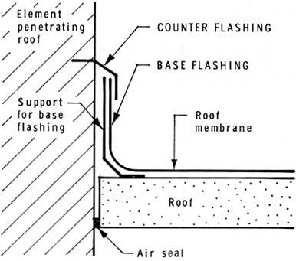
SECTION 5.407: WATER RESISTANCE AND MOISTURE MANAGEMENT
Standard building practice, California Building Code Section 1403.2
Implement use of non absorptive building materials
Flashings need to be installed properly
Sprinklers should not be spraying on structure
Storm drains need to dump away from building
No pooling of water near entrances
Proper flashing installation

Slide 41
SECTION 5.408: CONSTRUCTION WASTE REDUCTION, DISPOSAL AND RECYCLING
Similar to Residential requirements

Slide 42
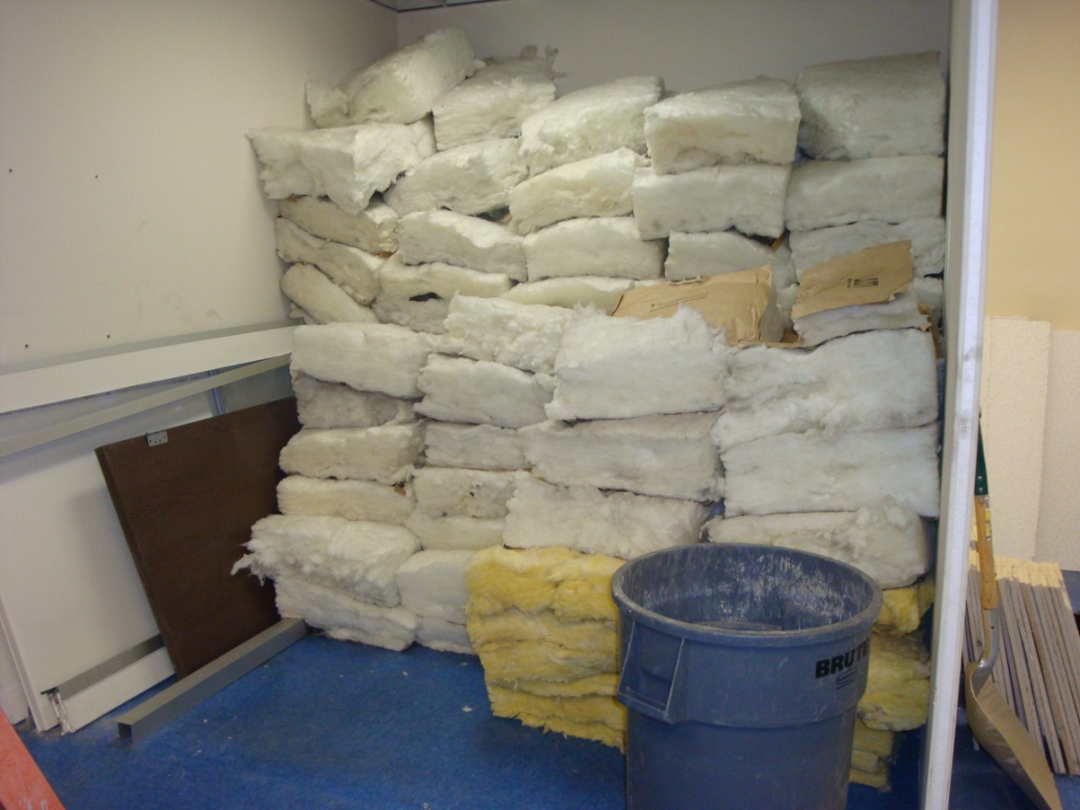
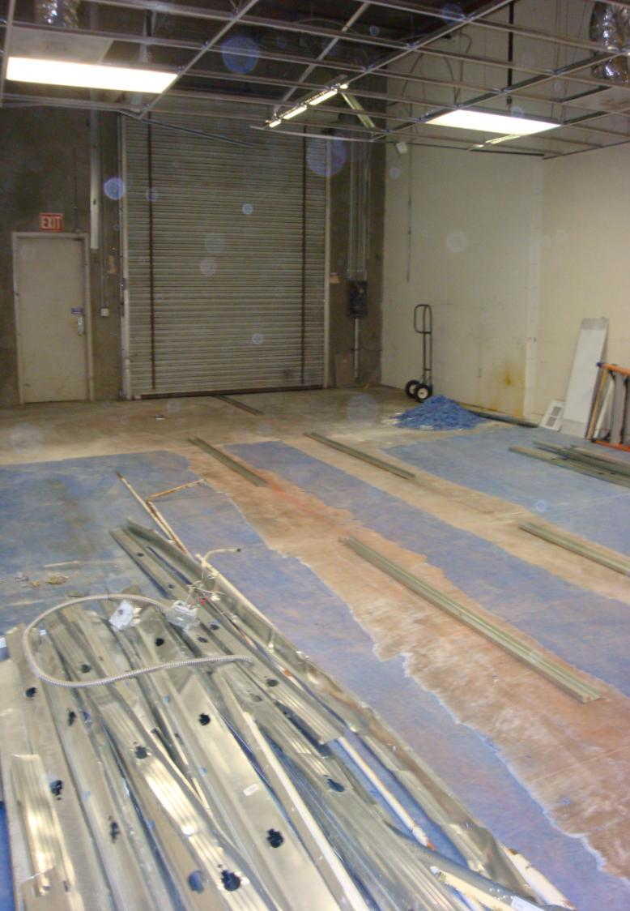
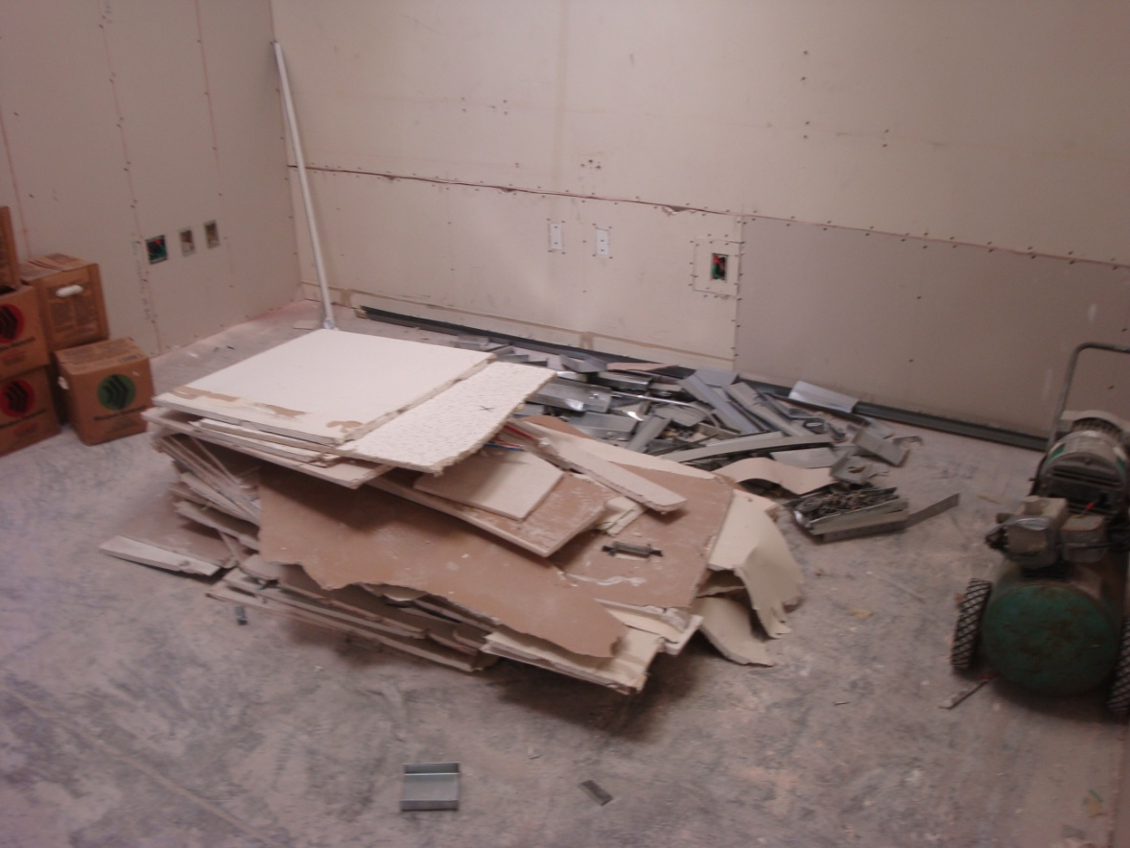

Slide 43
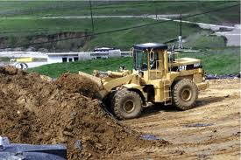
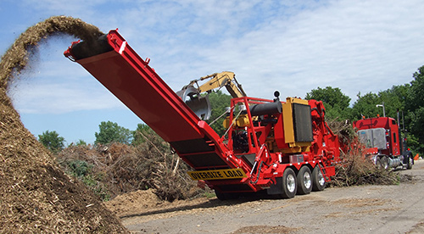
5.408.4 Excavated soil and land clearing debris
100% of trees, stumps, rocks and associated vegetation and soils resulting primarily from land clearing shall be reused or recycled.
A vegetation grinding/recycling service can assist with 100% diversion
Land clearing debris should be addressed in the WMP
Check to see if local ordinances are in place/being adhered to

Slide 44
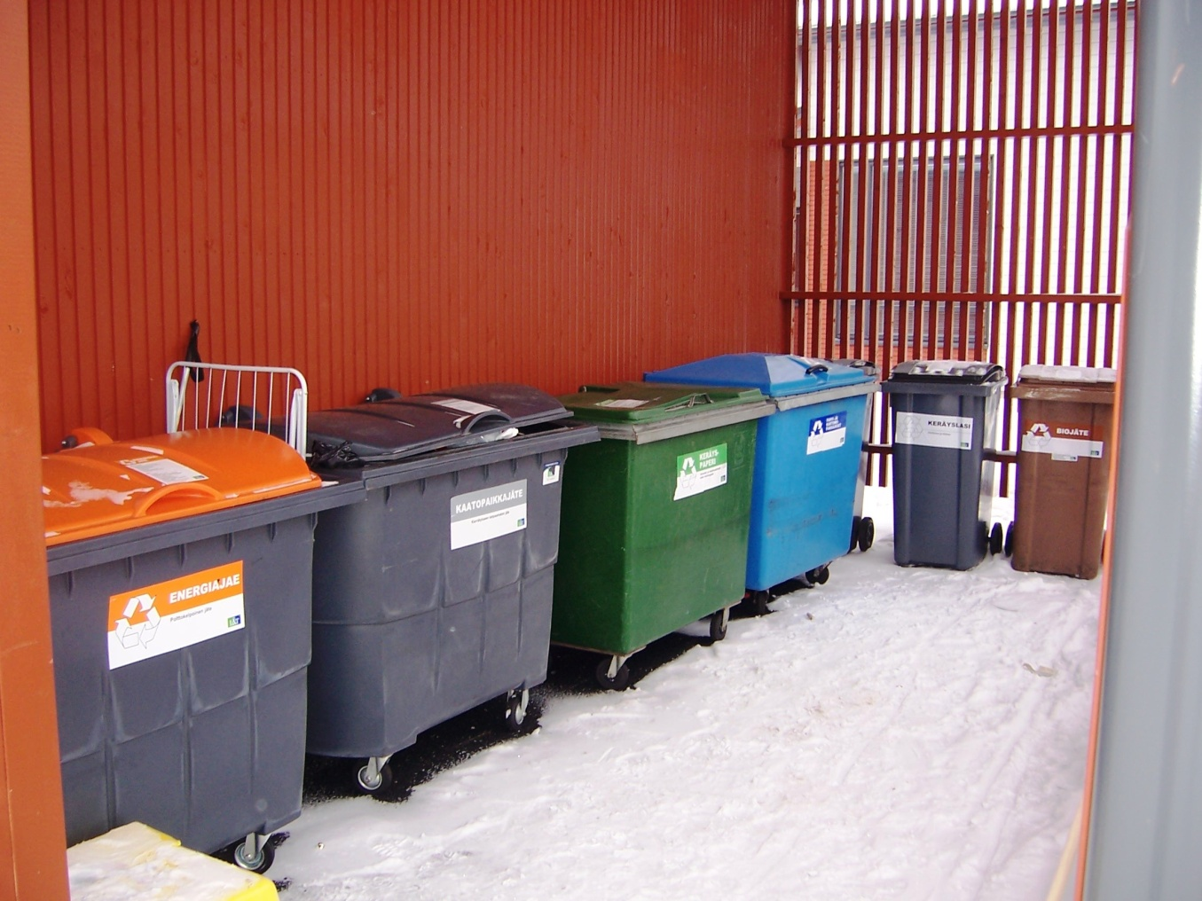
SECTION 5.410: BUILDING MAINTENANCE AND OPERATION
5.410.1 Recycling by occupants
Plan sets should identify recycling areas
Typically one central area
Inspect that recycling areas have been designated prior to final inspection

Slide 45
5.410.2 Commissioning
For new buildings 10,000 square feet or more:
5.410.2.1 Owner’s or Owner representative’s Project Requirements (OPR)
5.410.2.2 Basis of Design (BOD)
5.410.2.3 Commissioning plan
5.410.2.4 Functional performance testing
5.410.2.5 Documentation and training
5.410.2.5.1 Systems manual
5.410.2.5.2 Systems operations training
5.410.2.6 Commissioning report
5.410.4 Testing and adjusting
5.410.4.2 Systems
5.410.4.3 Procedures
5.410.4.3.1 HVAC balancing
5.410.4.4 Reporting
5.410.4.5 Operation and maintenance (O &M) manual
5.410.4.5.1 Inspections and reports

Slide 46
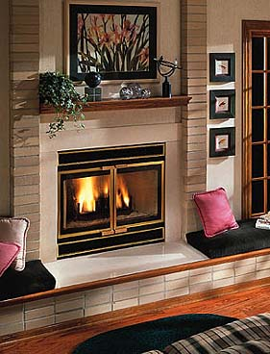
Division 5.5 – ENVIRONMENTAL QUALITY
SECTION 5.503: FIREPLACES
Shall comply with local ordinances
Wood/pellet stoves need to yield Phase 2 particulate matter emission level of 5.1 g/kg
Verify products meet these standards
Sealed Wood Fireplace
Sealed Pellet Stove

Slide 47
Division 5.5 – ENVIRONMENTAL QUALITY
SECTION 5.504: POLLUTANT CONTROL
Same as Residential standards
5.504.3 Covering of duct openings
5.504.4 Finish material pollutant control
Adhesives, paints, caulking etc.

Slide 48
5.504.5.3 Filters.
MERV 8 Filters
Ensure filters are installed properly (final inspection)
5.504.7 Environmental tobacco smoke (ETS) control
Including outdoor intakes

Slide 49
SECTION 5.506: INDOOR AIR QUALITY
Refer to Basis of Design documentation and mechanical drawings to verify that the proper mechanical systems have been installed
5.506.2 Carbon dioxide (CO2) monitoring
Should ideally be connected to a demand response system
Ensure that CO2 sensors are installed between 1’ and 6’ off the floor.
CO2 concentrations less than or equal to 600 ppm
A lack of adequate fresh air can make building occupants drowsy and uncomfortable.

Slide 50
SECTION 5.507: ENVIRONMENTAL COMFORT
5.507.4.1 Exterior noise transmission
Sound Transmission Class (STC) Walls – 50, Windows 30.
A simple check is required that building materials meet plan specifications
Field verify envelope installation
Siting is important

Slide 51
SECTION 5.508: OUTDOOR AIR QUALITY
5.508.1.1 Chlorofluorocarbons (CFCs)
1990 Kyoto Protocol started the ban of CFCs
New equipment needs to be specified since they do not contain CFC or Halons.
Note that while newer HVAC systems and refrigeration equipment are designed to operate on a new generation of refrigerants that do not contribute to greenhouse gases, CFCs and Halons are still used in recharging existing equipment. New equipment must be specified and installed, and is typically required for new projects.

Slide 52
Amendment to CalGreen Code Effective July 1, 2012
SECTION 5.106 SITE DEVELOPMENT
Focus more on Best Management Practices (BMPs) to minimize runoff
Remove reference to NPDES
5.106.4 Bicycle parking
The proposed modification deletes a reference to the University of California Policy on Sustainable Practices
5.106.5.2 Designated parking
Stalls shall be marked as: CLEAN AIR/VANPOOL/EV
5.303.1 Water Meters
For buildings in excess of 50,000 s.f and us of 100 gal/day, sub systems need to be sub metered
5.504.1.3 Temporary ventilation (NEW)
Allows limited use of the permanent heating and cooling system during construction and requires the use of air filters with a Minimum Efficiency Reporting Value (MERV) of 8.

Slide 53
Continued: Amendment to CalGreen Code Effective July 1, 2012
DIVISION 5.7:
ADDITIONS AND ALTERATIONS TO EXISTING NONRESIDENTIAL BUILDINGS (NEW)

Slide 54
Code Requirements from Other Agencies
City of Manhattan Beach – 15% Above Title-24
2-Unit Condo: New construction, 2-unit attached multi—family residential (condominium) measuring 5,202 square feet of conditioned area. Framed walls are insulated to R-19. Basement retaining walls are insulated to R-13. Two 50 gal. water heaters 0.60 EF. 470 sf floor area insulated R-30 batts. Contemporary design. 37.8% glazing to conditioned floor area.
ECM-6: Quality insulation installation, HERS Required. Initial Incremental Cost = $675.00 (for 2 systems)
ECM-8: Furnace upgrade - AFUE 80% to 95%. Initial Incremental Cost = $600.00 (for 2 systems)
http://www.energy.ca.gov/title24/2008standards/ordinances/

Slide 55
Cont. Code Requirements from Other Agencies
HERS – Home Energy Raters
CalCerts issues the HERS rating in California
What HERS Raters do:
Analysis of a home's construction plans and onsite inspections
EnergyPlus is used to model pre-construction/pre-retrofit
Meet Energy Star Guidelines
Conducts on-site inspections after construction/implementation
HERS is applied to:
Most Title-24 credit compliance measures
Insulation & Air sealing for New Solar Homes Partnership for California Advanced Homes
Title-24 permitting for HVAC (Duct testing , refrigerant charge verification)
2013 Duct Testing for all of CA for new HVAC installation & alterations
Energy Upgrade California Require HERS Testing – In & Out
Cities may require HERS testing on rebates
Commercial Title-24 Efficiency% increase in 2013 (AHSRAE/HERS)
AB 1103 In effect July 1, 2012 (maybe)

Slide 56
Typical HERS Testing
Duct Testing
Blower Door Testing

Slide 58
Thank you!!
Discussion, Q&A
Moe Fakih, MPA, LEED AP O+M, BPI, CGBP
AEF Consulting, Engineering & Construction, Inc.
General B, C-10 License #943423
mfakih@aefincusa.com
949-478-2344

