Slide 1
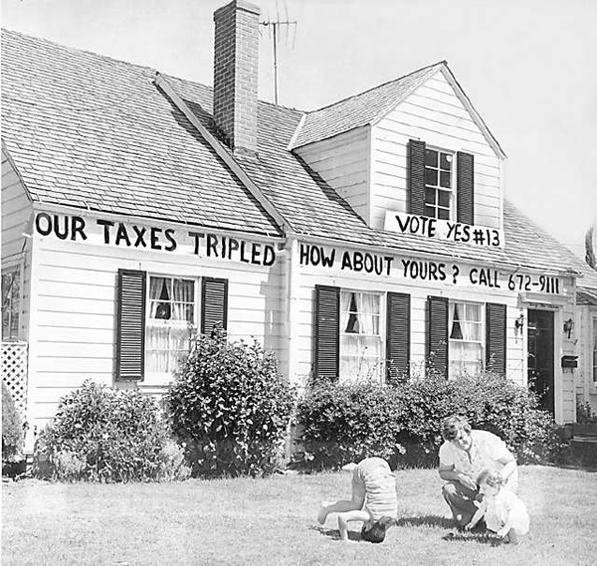
A Brief History & Enduring Legacy of Prop 13
Jeff Kiernan
Regional Public Affairs Manager
League of California Cities
Prepared for the South Bay COG Board of Directors Meeting 10/24/2013

Slide 2
Background
Before Prop 13, State and local governments set their own property tax rates, which averaged ~3% of market value.
From 1971 to 1978 the median home price rose 164% - far outpacing gains in both income and inflation, leading to public outcry for help.
Increase in CA Median Home Price
40%
35%
30%
25%
20%
15%
10%
5%
0%
‘71
‘72
‘73
‘74
‘75
‘76
‘77
‘78
Source: CA Association of Realtors

Slide 3
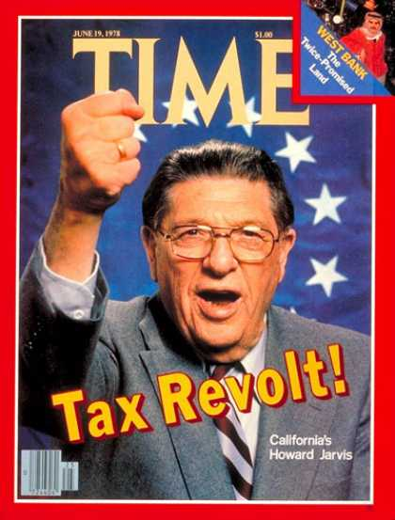
Enter Howard Jarvis…
His LA home, purchased for $8,000 in 1941, which was assessed at $80,000 in 1976.
Jarvis began circulating initiative petitions for simple property tax reform which he also argued would enact a necessary constraint upon the size of government
Notes:
Tried collecting signatures for a similar proposition in 1977, but failed to gather enough to qualify.

Slide 4
The Legislature Fails to Act
Prop 13 was the fourth attempt by Jarvis to put a tax reform measure on the ballot.
In 1977, under threat of yet another reform initiative, the CA Legislature proposed 22 different tax reform plans, but adjourned in the fall of 1977 without passing any of them
Voters reacted by signing petitions and the Jarvis proposition secured a place on the ballot.
Upon reconvening in 1978, the Legislature put a watered down measure on the ballot alongside Prop 13, but it failed.

Slide 5
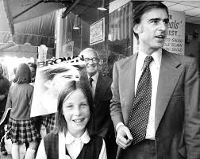
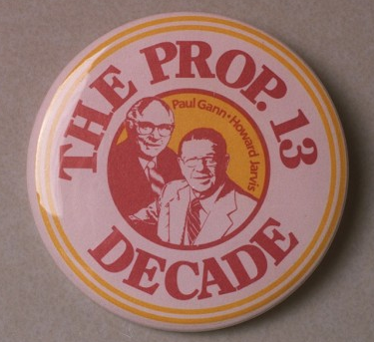
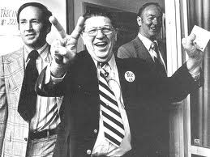
The 1978 Election
June 6, 1978: Prop 13 was passed by California voters on a statewide gubernatorial primary ballot.
It received more then 4.2 million votes or ~62%
Also on the ballot: Incumbent Governor Jerry Brown
Gov. Brown did not support Prop 13 during the primary, but afterward announced “the people have spoken, and as Governor I will diligently enforce their will.”

Slide 6
Prop 13: Immediate Effects
Property tax revenues fell by 57% or about $6 billion dollars in the first year
Provided stability for property owners
Lower property tax bills actually meant a windfall of increased personal income revenue for the state and federal governments
The Legislature quickly passed SB 154 – a bailout of local governments – and followed up with AB 8 the following year. These bills created much of the local government funding formula still in place today.
The property tax is no longer a local tax; it is collected by the State and redistributed to the local governments.
School Districts: now funded primarily through the state budget using a complicated formula.

Slide 7
Prop 13 Basics
Limits property tax rate to 1% of full market value
Caps the increase in property value at 2% with reassessment at full market value only upon change of ownership*
Rolled back property values for tax purposes to 1976 levels
Requires 2/3 voter approval to raise “special taxes”
Requires any increase in state taxes to be approved by 2/3 vote of the state legislature
Effectively transferred the authority for allocating property tax revenues from local government to the state.

Slide 8
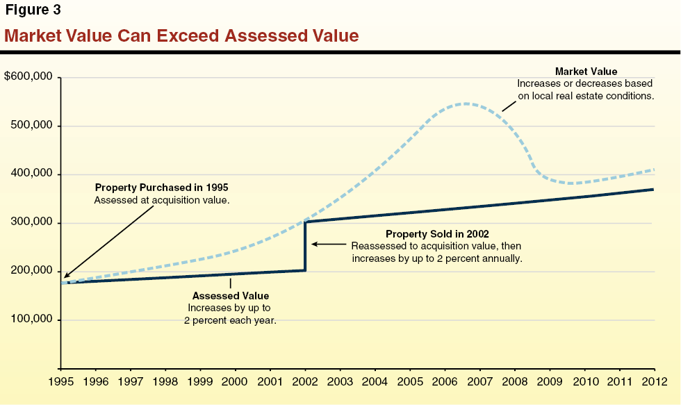
Prop 13 In Practice
Source: Legislative Analyst Office

Slide 9
*Improvements are Assessed Separately
E.g. If you purchased a home in 2002 and added a garage in 2010, the home and the garage would be assessed separately – each based on the market rate when they were acquired.
Specific property improvements that do not increase the assessed value:
Reconstruction following a natural disaster (1978)
Solar energy construction (1980)
Fire-safety improvements (1984)
Accessibility construction (1990 & expanded in 1994)
Reconstruction/repair of environmental contamination (1998)
Seismic safety improvements (2o10)
Notes:
ALSO touch on reduction of assessed value when market values FALL.

Slide 10
Prop 13: City Perspective
Prop 13 took control of property tax away from cities, with no acknowledgement of service demands, differing property value or willingness to pay.
Stable & Predictable Revenue Stream
Fiscalization of Land Use
Reliance on sales tax shifts cities land use priorities
The Rise of Fees
Construction/Development
Transient Occupancy Tax
Notes:
Big Box Retail, auto dealerships

Slide 11
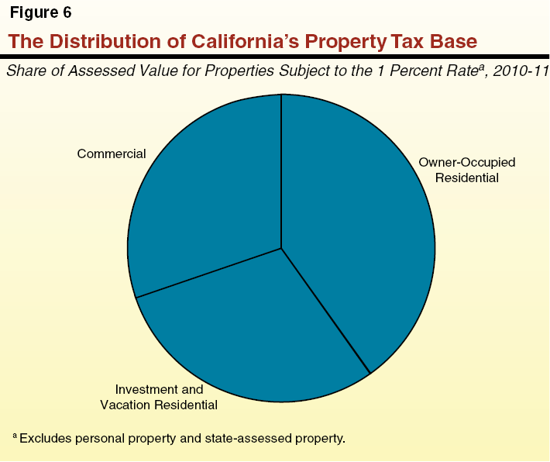
Prop 13:Who Pays?
In 2010-11:
Owner occupied homes account for value of $1.6 trillion
Commercial properties account for $1.2 trillion
Investment/Rental properties account for $1.4 trillion
28%
39%
34%
Source: Legislative Analyst Office

Slide 12
Prop 13 Reform?
Split Roll: Do businesses pay their fair share?
Less turnover in ownership
Higher market value relative to home prices
Predictability of property tax is a bright-spot for businesses in CA’s tax rich environment

Slide 13
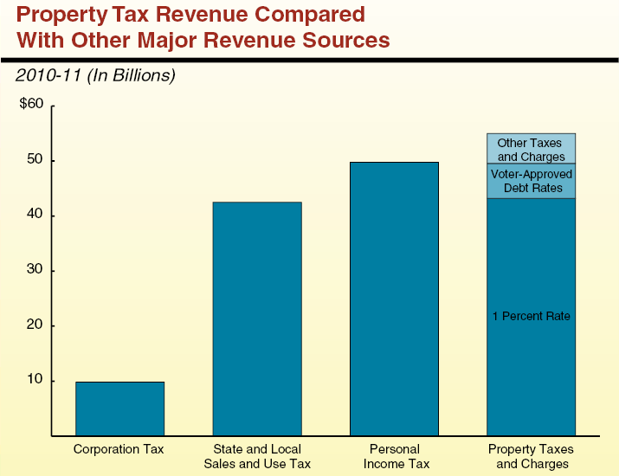
Prop 13: How much is 1% worth?
In 2010-11, $55 billion was collected in property tax revenue.
$43.2b from the 1% plus $5.7b from voter approved additions
Source: Legislative Analyst Office

Slide 14
ERAF: The Educational Revenue Augmentation Fund
A reduction of the “bailout” funds originally spent under the 1978 AB 8 legislation.
Cities incorporated AFTER 1978 were not liable
$6 billion annual on-going shift of city, county and special district property tax revenue to the state general fund began in 1991-92.
by shifting to local schools thereby relieving state general fund obligation for school $
City property tax shares reduced by 24% (on average)
Most ERAF funds are now used to repay local governments for other local tax revenues cut by the state (VLF, Sales Tax).

Slide 15
Property Tax Revenues: A Constant Tug-of-War
Source: CaliforniaCityFinance.com

Slide 16
Prop 13: Legislative Proposals
SCA 3 (Leno) 55% Vote for School Parcel Taxes: Authorizes a parcel tax for specified programs or services by a school district, county office of education or a community college district. Prohibits funds from paying for administrator’s salaries. League Position: Support
SCA 4 (Liu) and SCA 8 (Corbett): 55% Vote for Transportation Special Taxes: Authorizes a special tax by a local government to provide funding for local transportation projects. Requires the Legislature to define “local transportation projects.” League Position: Support
SCA 7 (Wolk) 55% Vote for Library Parcel Taxes, Special Taxes and Bonded Indebtedness: Authorizes a parcel tax, special tax or the issuance of debt backed by ad valorem property taxes for funding public libraries. League Position: Support
SCA 9 (Corbett) 55% Vote for Special Taxes for Local Community and Economic Development: Authorizes a special tax for funding local community and economic development public projects by local government with a 55% vote. Defines “community and economic development” to include projects that improve, upgrade or revitalize areas that have become blighted because of deterioration, disuse or unproductive economic conditions. League Position: Support
SCA 11 (Hancock) 55% Vote for Parcel Taxes and Special Taxes for Local Purposes: Authorizes a parcel tax or a special tax for general local government purposes. This is the most flexible of the measures introduced so far and allows more discretion for affected communities to identify their priorities. League Position: Support
ACA 3 (Campos) 55% vote for Public Safety Buildings and Supplemental Services Special Taxes and Bonded Indebtedness: Authorizes a special tax or bonded indebtedness for funding the construction of local public safety buildings and augmenting public safety services with a 55% vote.
ACA 8 (Blumenfield) 55% vote for Public Safety Buildings Bonded Indebtedness: This measure authorizes bonded indebtedness with a 55% vote for funding a wide variety of infrastructure, public improvements and local public safety buildings. League Position: Support

Slide 17
Questions?
Jeff Kiernan
Regional Public Affairs Manager
League of California Cities
Prepared for the South Bay COG Board of Directors Meeting 10/24/2013
Save the Date
3rd Annual All Cities Holiday Reception
5:30 – 8 PM on Thursday, December 5th
Ernst & Young: 725 South Figueroa St. Los Angeles

Slide 18
Latest Progeny of Prop 13
Prop 218: The Right to Vote on Taxes Act (1996)
Prop 26: Supermajority Vote to Pass New Taxes & Fees (2010)
Voter approval required on taxes
General Taxes limited to cities & counties
Special Taxes Require 2/3rds approval
Restrictions on Fees
Limits on parcel taxes & property assessments
May not exceed the cost of providing the service.
Expands the definition of a State or Local Tax
Voter approval required for any new state tax (in addition to a vote by 2/3rds of the legislature)

Slide 19
Leading Sources of CA City Revenues
Source: CaliforniaCityFinance.com

Slide 20
That Asterisk…
Limits property tax rate to 1% of full market value
Caps the increase in property value at 2% with reassessment at full market value only upon change of ownership*
Rolled back property values for tax purposes to 1976 levels
Requires 2/3 voter approval to raise “special taxes”
Requires any increase in state taxes to be approved by 2/3 vote of the state legislature
Effectively transferred the authority for allocating property tax revenues from local government to the state.

Slide 21
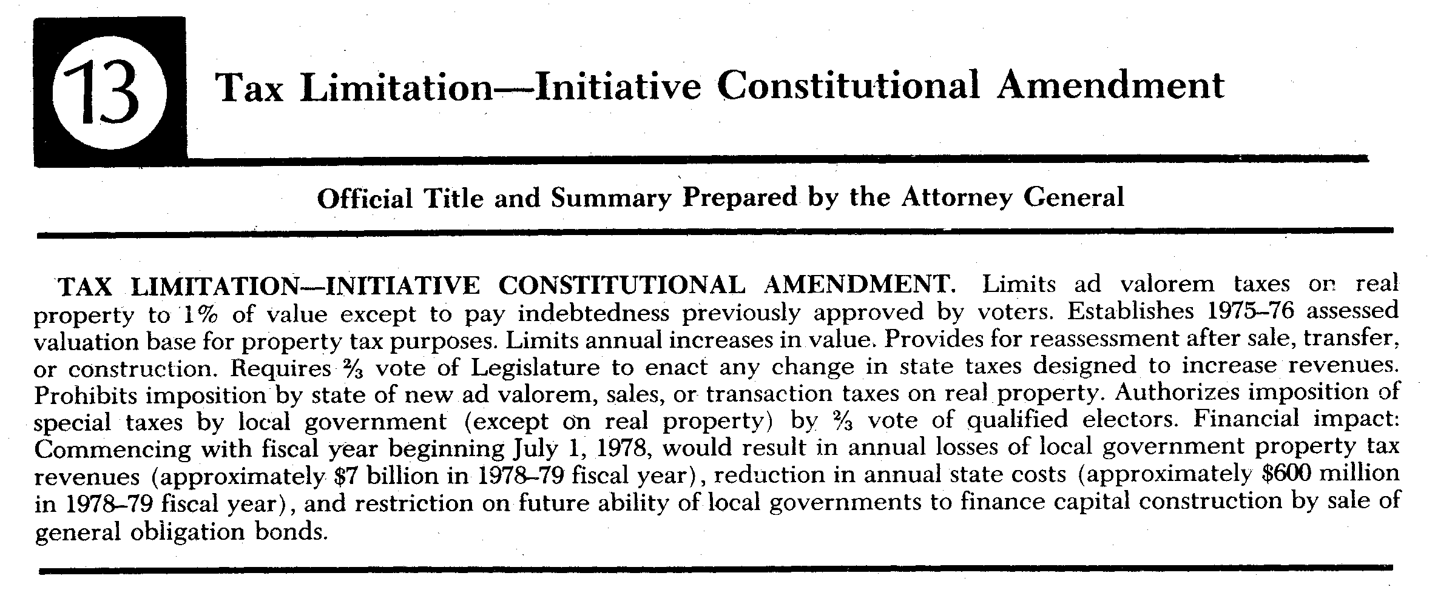
Proposition 13: The People’s Initiative to Limit Property Taxation (1978)

